Slide 1

Defense Presentation: File Encryptor
By: Jacob Braddock
Major: Cybersecurity
Advisor: Michael O'Neil
April 25th, 2025

Slide 2
Statement of purpose
Data privacy is becoming more and more at risk due to the increase of data and privacy and breaches as the internet grows
People should be able to protect their own files and data as they see fit with the proper tools

Slide 3
Background and Research
File encryption is one of the many ways people keep their files safe
Creating a cryptographic key can be derived from the password to allow for the symmetric encryption, such as Advanced Encrypting Standard (AES)
AES is the most standard current algorithm of today
This project plans combine this encrypting algorithm with the generated key from the password and salt using PBKDF2 (Password Based Key Derivation Function) with SHA256 (hashing algorithm)

Slide 4
Hardware, Software, Language
Coded in Java and Java Swing for the GUI
Used Netbeans as the software and coding enviornment
Coded on a Macbook Pro Model M1 with 8GB of Memory

Slide 5
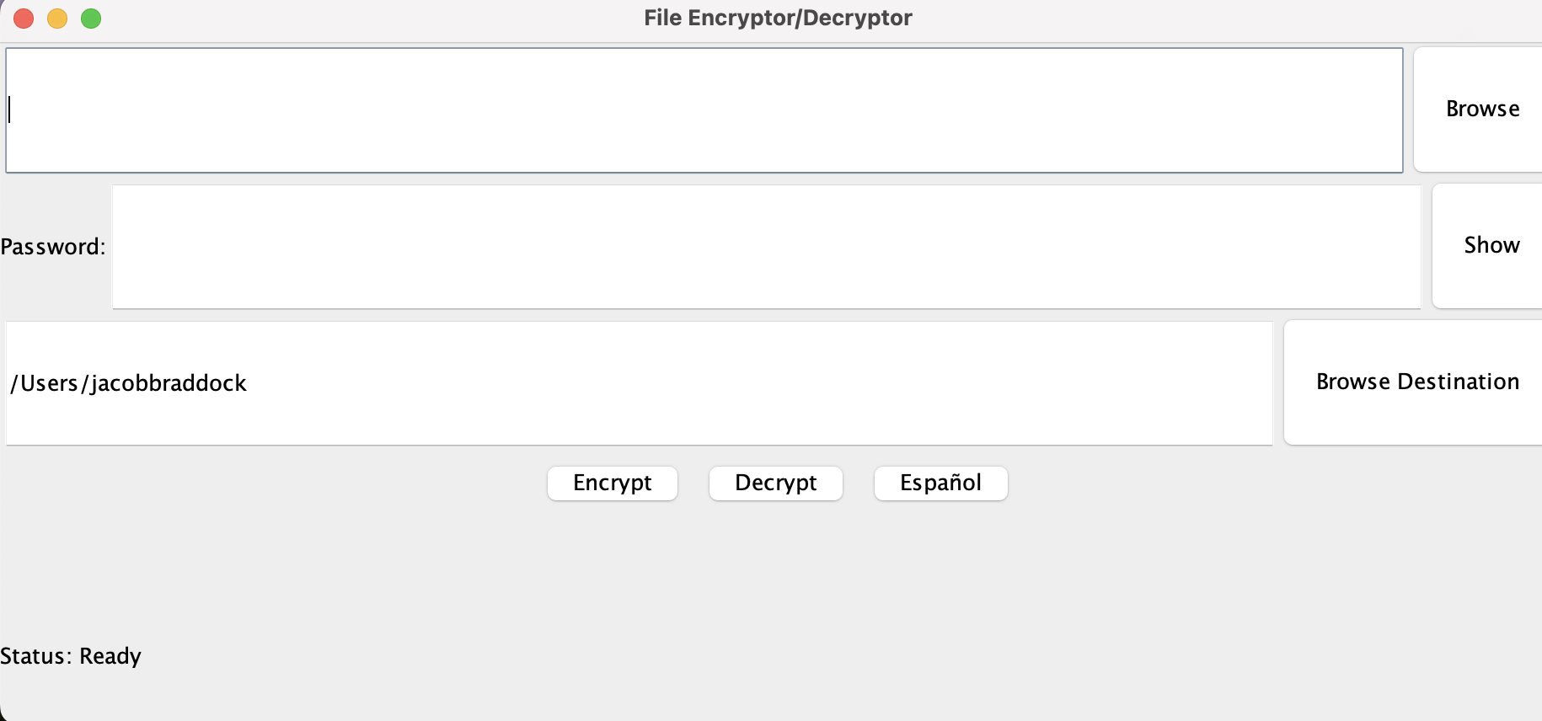
DEMO TIMe

Slide 6
Challenges
Having to learn all about encryption and hashing algorithms pretty early on by myself
Coding said algorithms in NetBeans
Making sure the GUI actually properly was put together for this project

Slide 7
Enhancements
Upgrade from an Application to a Website
Update the GUI to look more presentable and user friendly than overly basic
More easily accessible on other devices if staying an application

Slide 8
Questions?
Data Privacy nowadays is coming more and more at risk due to increased data breaches
The creation of a more accessible way to keep users personal data safe on their own devices

